Slide 1
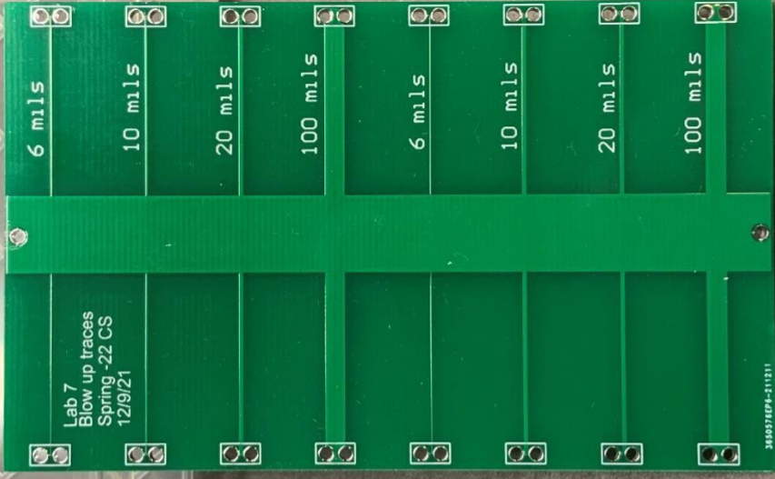
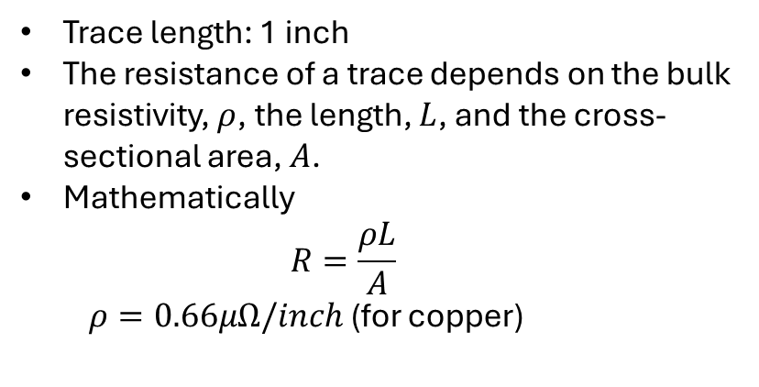
Lab 11 and 12 Report
Joseph Abroquah
Data Collected: 11/10/2025
Goal: To estimate PCB trace resistances, measure it using 2-wire and 4-wire methods, compare measurement accuracy and determine the maximum current the traces can safely carry before burning.
A 2-layer board with different traces
POR:
  Use DMM to measure the 2-wire resistance of each trace.
  Use the 4-wire measurement method to measure the voltage drop across the traces, then calculate the resistance based on Ohm’s law.
  Using the 4-wire method, progressively increase the current through the 6 mil trace to determine their maximum current capacity before they begin to smoke.
Trace length: 1 inch
The resistance of a trace depends on the bulk resistivity, $ρ$, the length, $L$, and the cross-sectional area, $A$.
Mathematically
  $$R=\frac{ρL}{A}$$
  $ρ=0.66μΩ/inch$ (for copper)

Slide 2
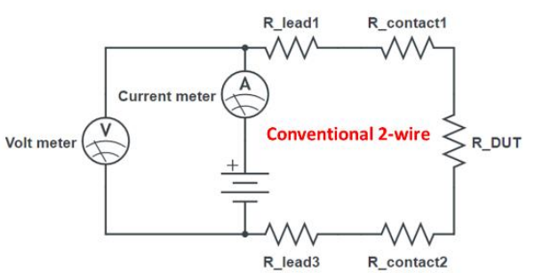
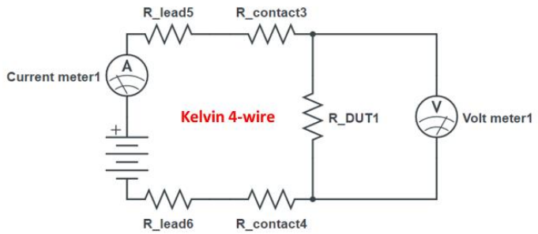
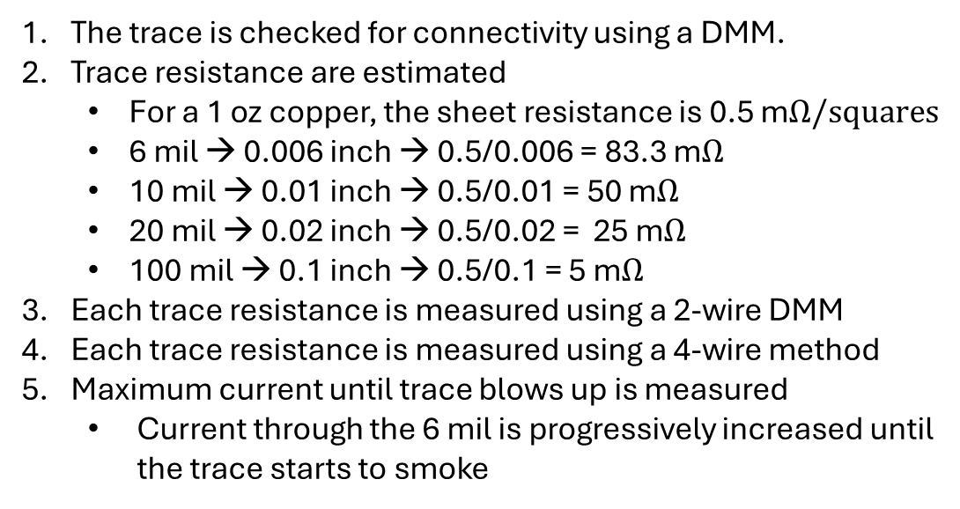
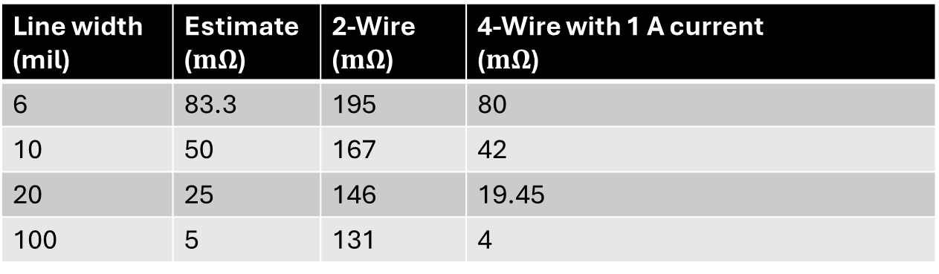
Experiments
The trace is checked for connectivity using a DMM.
Trace resistance are estimated
  For a 1 oz copper, the sheet resistance is 0.5 m$Ω/squares$
  6 mil → 0.006 inch → 0.5/0.006 = 83.3 m$Ω$
  10 mil → 0.01 inch → 0.5/0.01 = 50 m$Ω$
  20 mil → 0.02 inch → 0.5/0.02 = 25 m$Ω$
  100 mil → 0.1 inch → 0.5/0.1 = 5 m$Ω$
Each trace resistance is measured using a 2-wire DMM
Each trace resistance is measured using a 4-wire method
Maximum current until trace blows up is measured
  Current through the 6 mil is progressively increased until the trace starts to smoke
Schematic for 2-wire method
Line width (mil) | Estimate ($mΩ$) | 2-Wire ($mΩ$) | 4-Wire with 1 A current ($mΩ$)
6 | 83.3 | 195 | 80
10 | 50 | 167 | 42
20 | 25 | 146 | 19.45
100 | 5 | 131 | 4
Schematic for 4-wire method

Slide 3
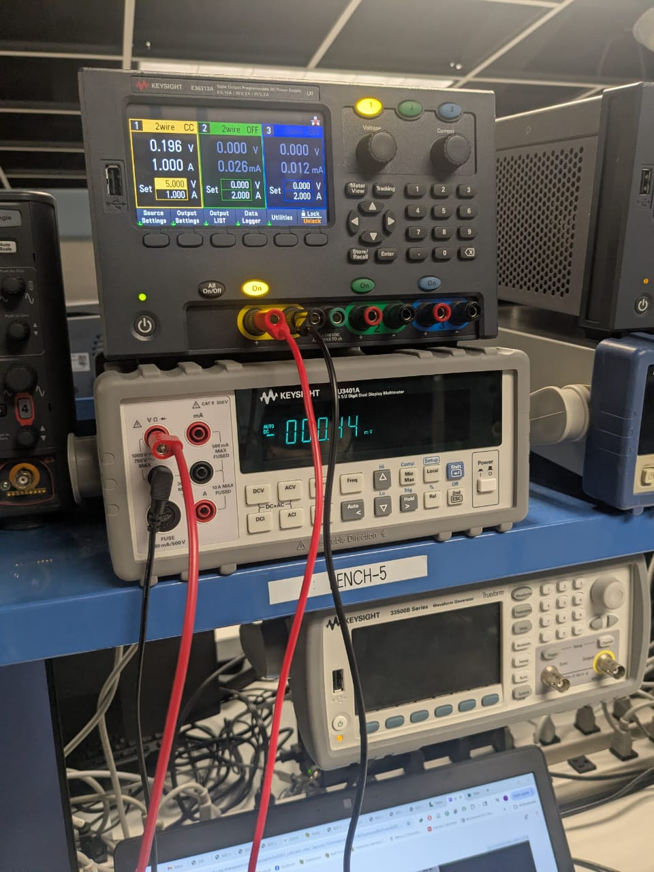
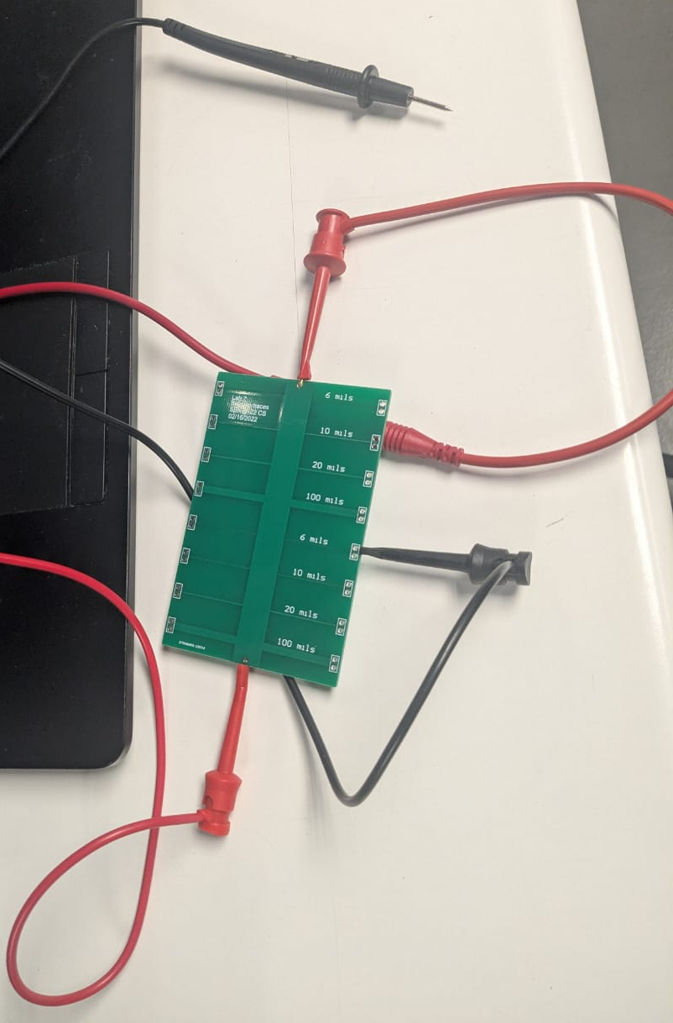
Figures of 4-wire measurement method

Slide 4
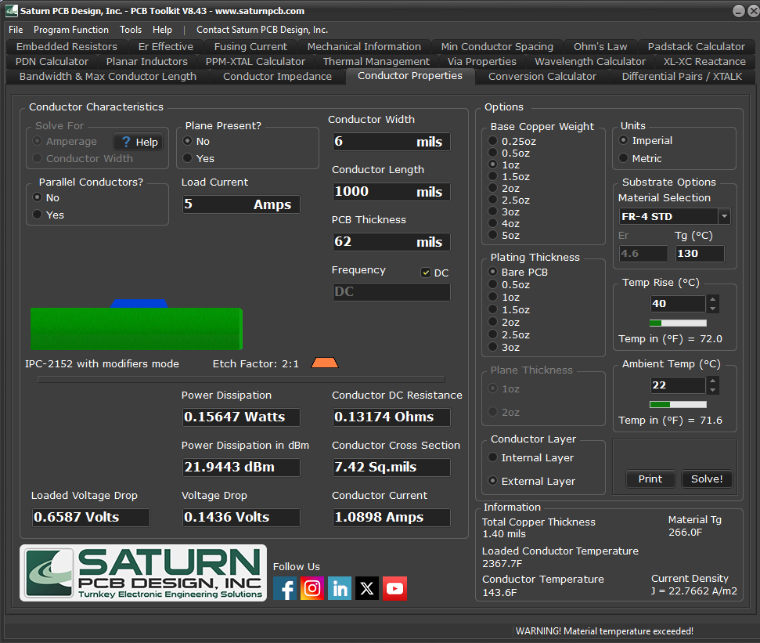
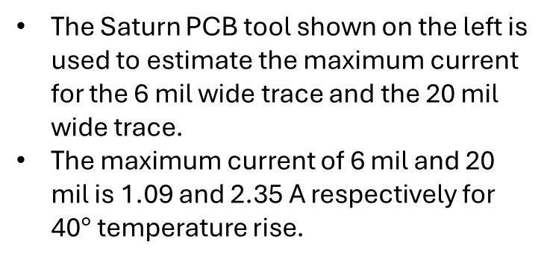
Max current handling capacity
The Saturn PCB tool shown on the left is used to estimate the maximum current for the 6 mil wide trace and the 20 mil wide trace.
The maximum current of 6 mil and 20 mil is 1.09 and 2.35 A respectively for 40$°$ temperature rise.

Slide 5
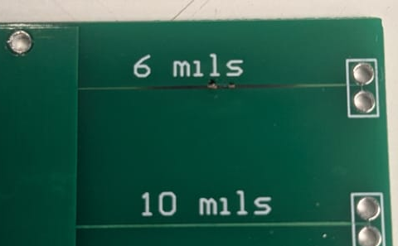
Findings
The results of the 2-wire method are more accurate for measuring large resistances. For lower resistances, their accuracy is impacted by contact and lead resistance.
The 4-wire method provides a more accurate measure of trace resistance by eliminating the effects of the contact and lead.
  4-wire method is closed to calculated values
Using the 4-wire method, the maximum current until the 6 mil trace starts smoking is around 4.2 A.
  The burnt trace is shown in Fig. 1.
Fig. 1 Burnt 6 mil trace
Line width (mil) | Estimate ($mΩ$) | 2-Wire ($mΩ$) | 4-Wire with 1 A current ($mΩ$)
6 | 83.3 | 195 | 80
10 | 50 | 167 | 42
20 | 25 | 146 | 19.45
100 | 5 | 131 | 4

